Slide 1

Failover Network Using Redundant paths
Course Name: Computer Networks Lab
Course Code: 3204
Submitted By:
Istiak Alam [CSE20, ID-05]
Sazzad Jelani [CSE19, ID-03]
Nafisa Tabassum [CSE19, ID-08]
Sadia Islam Mim [CSE19, ID-10]
Submitted To:
Dr. Fernaz Narin Nur
Adjunct Professor
Department of CSE,NDUB

Slide 2
Problem Statement
In critical networks a single failure can shut down the entire system.
Database entries on hospitals
Transactions in banks
Administrator work in universities
Downtime results in service loss, financial cost, and reputation damage.
2

Slide 3
Objective
High Availability: If a link or device fails, network continues smoothly.
Automatic Recovery: No need for manual intervention.
Zero Downtime: For users, they don’t notice anything went wrong.
Enhanced Network Reliability: Essential for mission-critical applications.
3

Slide 4



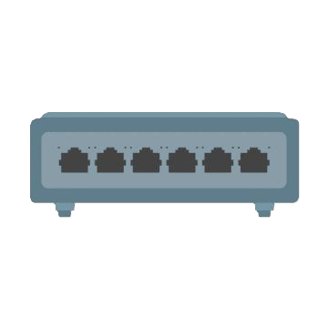


Solution
S1
S3
B
Sub-Building
Sub-Building
Virtual IP
S2
S4
Main Building
A
Sub-Building
Sub-Building

Slide 5
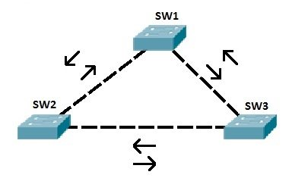
Background Study
STP (Spanning Tree Protocol)
STP is a network protocol used to prevent looping within a network topology.
STP was created to avoid the problems that arise when computers exchange data on a local area network (LAN) that contains redundant paths.
Fig 2 : Broadcast Storm
5

Slide 6
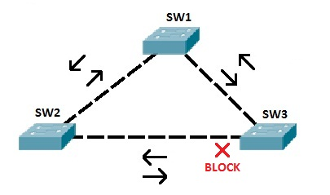
Background Study
STP (Spanning Tree Protocol)
STP uses the spanning tree algorithm to prevent loops.
In the topology above, STP has placed one port on SW3 in the blocking state.
That port will no longer process any frames except the STP messages. If SW3 receives a broadcast frame from SW1, it will not forward it out to the port connected to SW2.
Fig 3 : With Spanning Tree Protocol (STP)
6

Slide 7
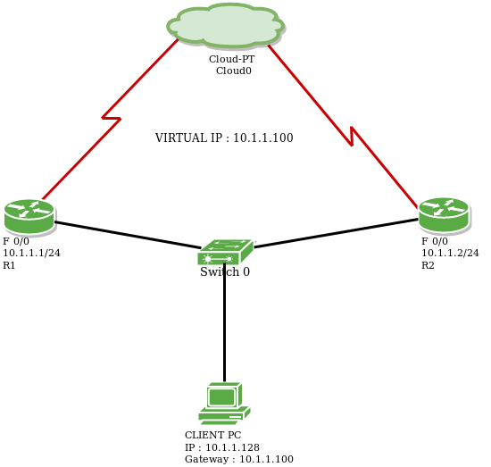
Background Study
HSRP(Hot Standby Router Protocol)
HSRP enables a set of router interfaces to work together to present the appearance of a single virtual router or default gateway to the hosts on a LAN. The virtual router does not exist; it represents the common target for routers that are configured to provide backup to each other.
In this protocol, one of the routers is selected to be the active router and another to be the standby router, which assumes control of the designated active router fail.
7

Slide 8
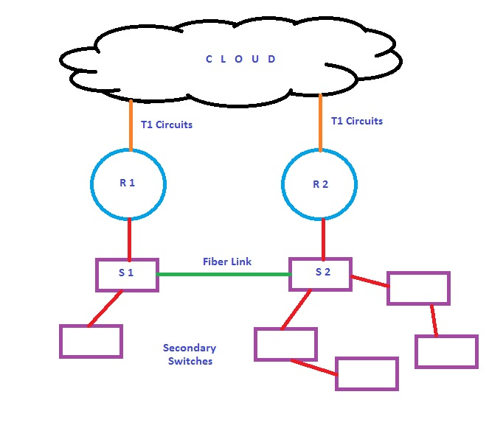
Background Study
Multigroup HSRP
In order to utilize both routers, we can configure Multigroup HSRP between two routers. Let us consider two groups of network :-
Router 1 is Active for group 1.
Router 2 is Active for group 2.
Each router is Standby (Backup) for the
alternative groups.
8

Slide 9
Reference
The Cisco Learning Network
Redundancy Protocol Configuration Guide
TechTarget Network

Slide 10
--Thank You--

